Slide 1
The battle of neighborhoods
Mexican restaurant location hunt
By Manitha

Slide 2
Business Problem
The objective of this project is to find the most suitable location to open a New Mexican restaurant in Phoenix. By using data analysis, and machine learning algorithms like clustering, this project aims to provide solutions to answer to the business problem.

Slide 3

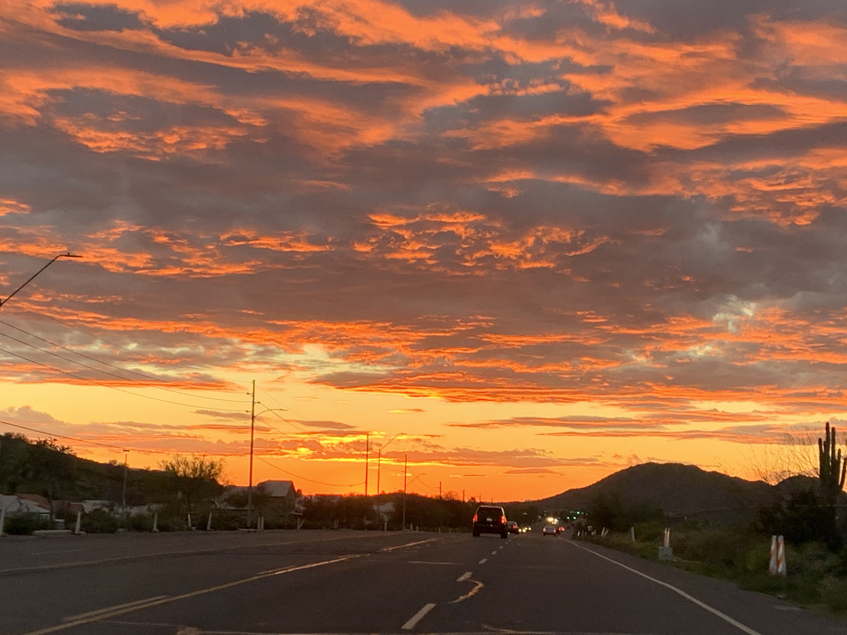
Phoenix
Phoenix is the anchor of the Phoenix metropolitan area, also known as the Valley of the Sun. Phoenix has long, extremely hot summers and short, mild winters. The metropolitan area is the 11th largest by population in the United States

Slide 4
Data Analysis Process

Slide 5
Data
To solve the problem, we need the following data:
List of Neighborhoods in the city of Phoenix
Latitude and Longitude of this Neighborhood
Venue data related to Mexican restaurants

Slide 6
Data Extraction
Scrapping of Phoenix Neighborhood data via Wikipedia
Getting the Latitude and Longitude of this neighborhood using the Geocoder package
Using Foursquare API to get the venues related to this neighborhood

Slide 7
Libraries and Packages
Pandas: For creating and manipulating data frames
Folium: Python visualization library to visualize the neighborhoods cluster distribution of using interactive leaflet map
Geocoder: To retrieve Location Data
Scikit Learn: For importing k-means clustering
silhouette_score: For finding the optimal value for K
JSON: Library to handle JSON files
Beautiful Soup: Web scraping
Requests: library to handle http requests
Matplotlib: Python Plotting Module

Slide 8
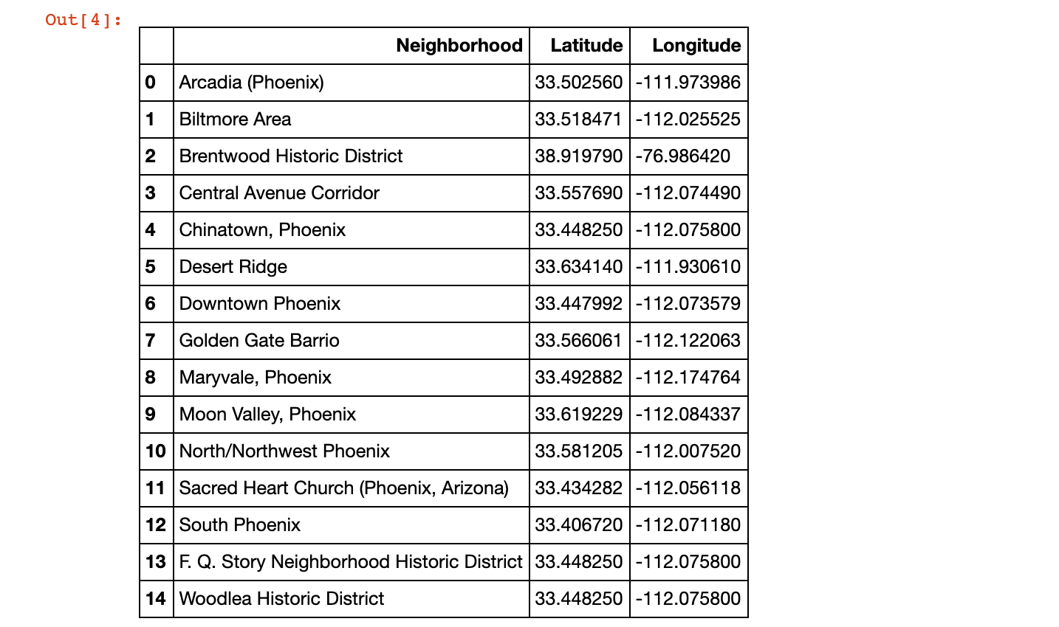
Web Scraping
Scrape data from Wikipedia using Beautiful Soup and convert into Dataframe
Caption

Slide 9
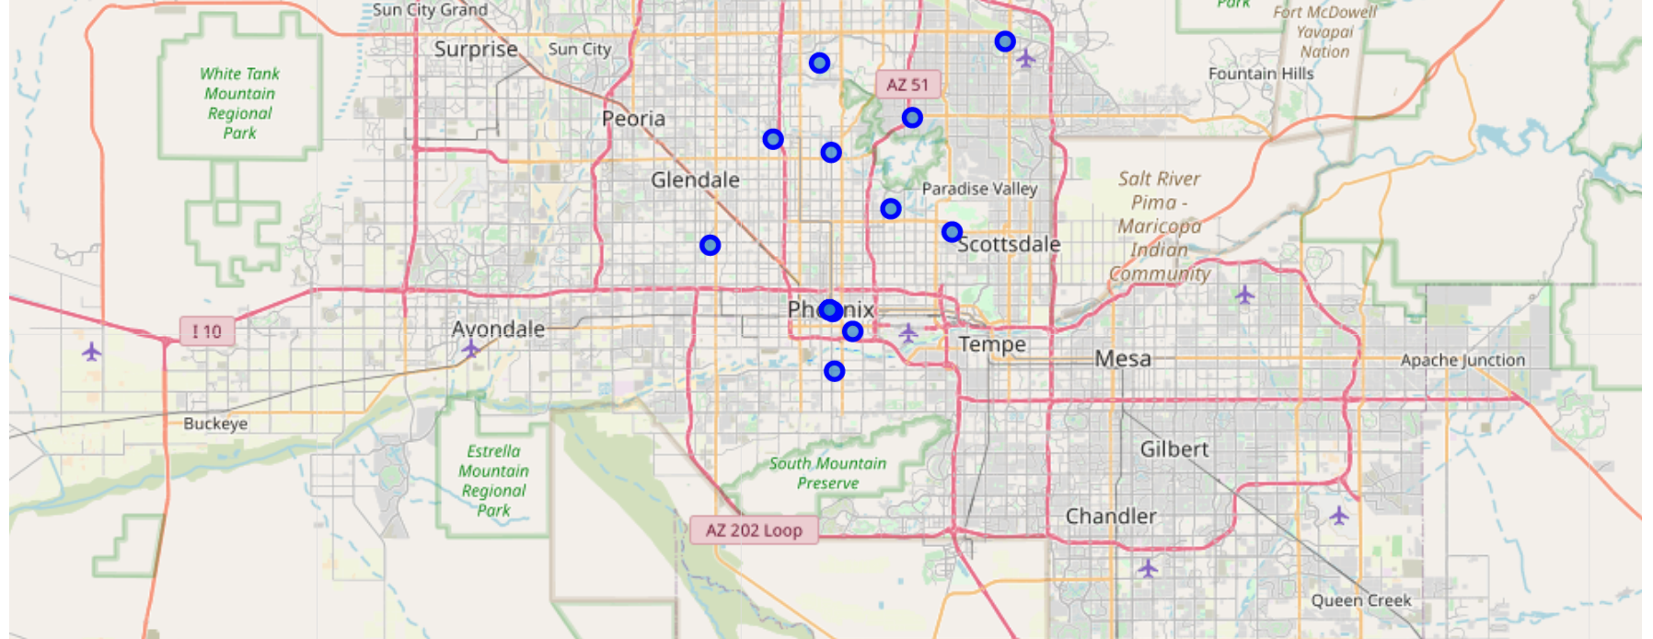
Data Visualization
Folium is used to visualize the data. The map of Phoenix is created using latitude and longitude values with its neighborhoods marked.
Caption

Slide 10
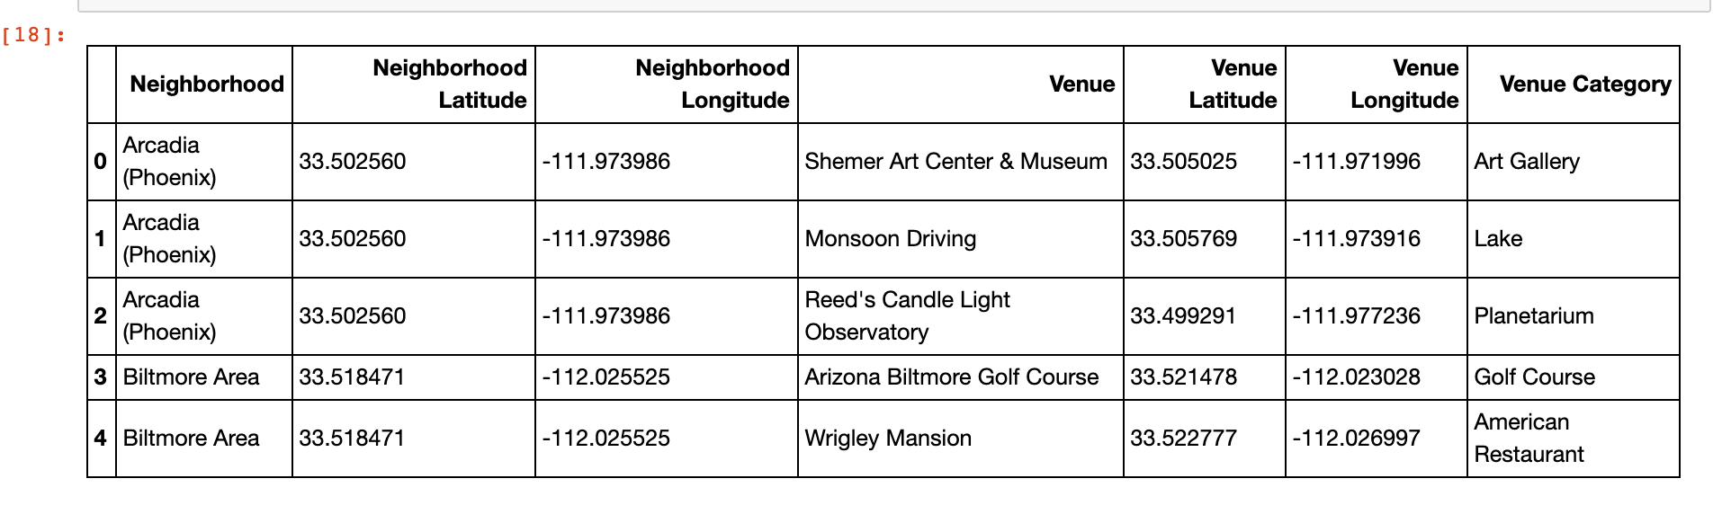
Foursquare API
Foursquare API is used to explore the neighborhood of Phoenix and to gather information about venues inside each and every neighborhood.

Slide 11
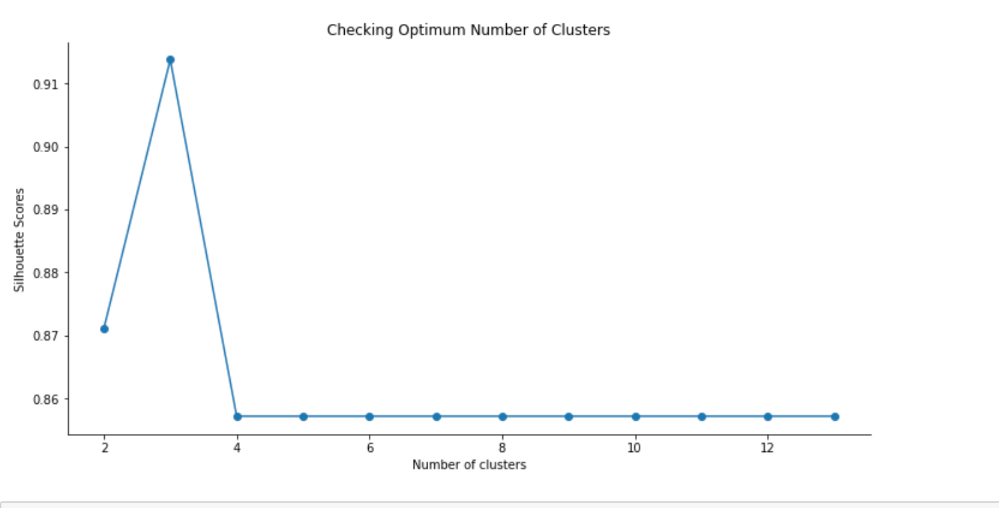
Machine Learning - Kmeans Clustering
Silhouette Scores method is used to find the Optimum number of Clusters.

Slide 12
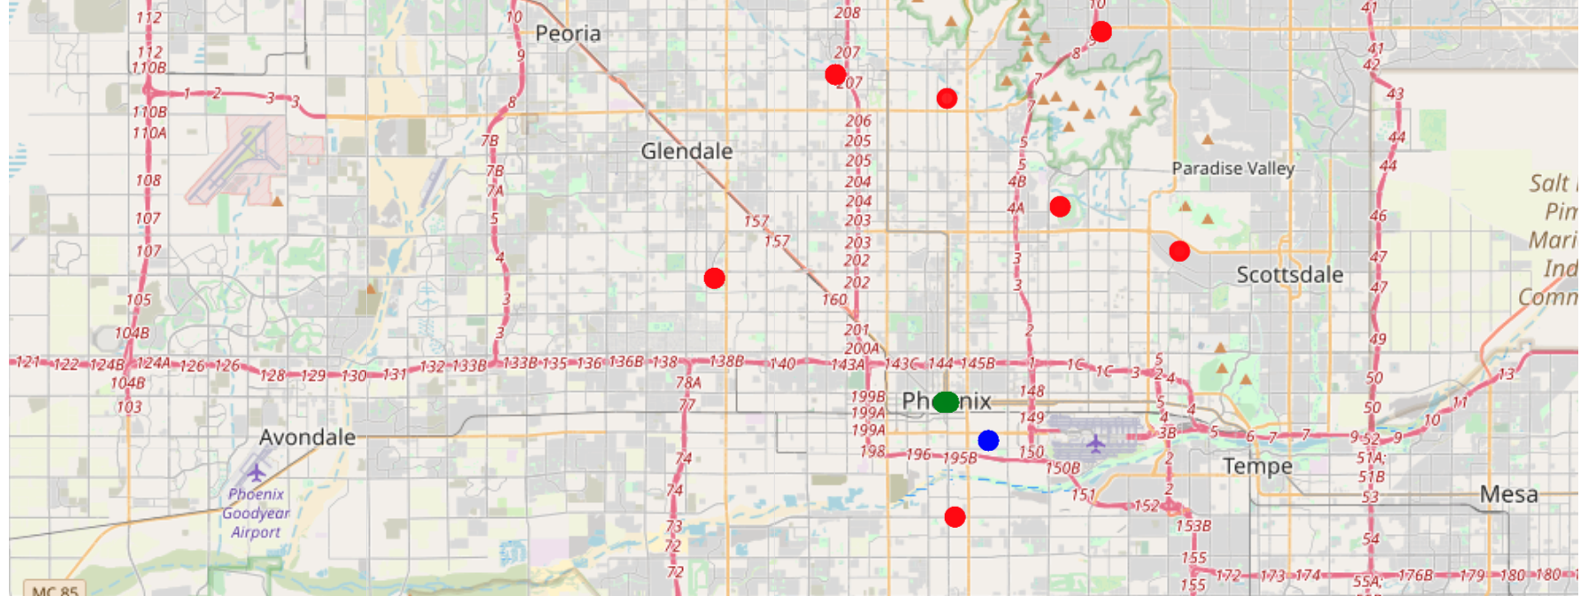
Machine Learning - Kmeans Clustering
Cluster labels is used to show the neighborhoods marked with a cluster-specific color on a map, again using folium.
Caption

Slide 13
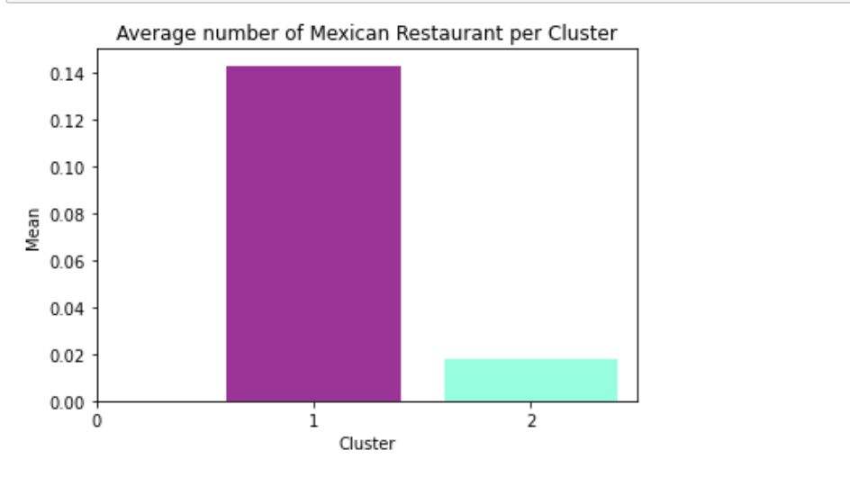
Neighborhood Cluster Bar Graph
Mexican Restaurants are filtered out from each cluster and the graph is plotted for all the Neighborhood Clusters to see the Mexican Restaurant occurrence.

Slide 14
Result
In the map given above, Cluster 0 (Red color) has no Mexican restaurants. Therefore, this project recommends the entrepreneur to open Mexican Restaurant in these neighborhoods with little to no competition.
Limitations
In this project, I took only one factor into consideration: the occurrence of Mexican restaurants in each neighborhood. There are many factors that can be taken into consideration such as population density, income of residents, rent that could influence the decision to open a new restaurant.

